Slide 1
Presentation to SNPP Kathy Cowley, President, FOKE
Lourdes Retirement Village
Planning Proposal 2022-658
15 December 2023

Slide 2
Summary
We support:
R2 zoning on northern portion of site;
Inclusion of C2 zoning
We oppose:
R3 zoning on southern portion of site;
Proposed increases in building height and FSR controls
We are very concerned that:
The proposal will put lives at risk and does not comply with Planning for Bushfire Protection 2019
Ku-ring-gai Council submission has been ignored and RFS advice is based on outdated data
Climate change is not even mentioned in the post-exhibition report
We ask that the SNPP:
Retain R2 zoning across the site, as per its 2018 decision (meaning no townhouses on the southern and eastern perimeter of the site)
Include a meaningful APZ/defendable space (e.g. no buildings south of First Ave, per Ku-ring-gai Council submission)

Slide 3
Incorporating natural hazard info is critical to avoid future disasters
“Land-use planning decisions have far reaching and long-lasting consequences as to how exposed and vulnerable the community will be to future natural hazards. Where land-use planning decisions do not effectively incorporate natural hazard risk, future impacts of natural disasters will be higher”.
NSW Department of Planning and Environment, Planning for a more resilient NSW – A strategic guide to planning for natural hazards, November 2021

Slide 4
We need to learn lessons from past disasters – not repeat past mistakes
The Royal Commission into National Natural Disaster Arrangements stated:
State and Local governments should “be required to consider present and future natural disaster risk when making land-use planning decisions for new developments”.
“Good land-use planning decisions can mitigate future risks. Decisions about new developments should be based on the best information available on current and future risks.”
The best information available in this case is the Council submission, not the BlackAsh material.

Slide 5
RFS advice ignores Council submission
RFS’s position of “no objection” to the proposal is based on BlackAsh advice which lacks an evidence base, other than outdated Council reports from 2012 and 2015.
Ku-ring-gai Council’s submission contains up to date and site specific modelling about the level of risk impacting the Lourdes site. It comprehensively contradicts the BlackAsh material but the Council analysis has been ignored.
FOKE made a GIPA application to RFS to seek evidence that RFS had considered the Council submission. NO EVIDENCE WAS PRODUCED.
We expressed our concern to Commissioner, noting that RFS advice was likely to determine the matter. He stated in reply that
“It is premature to speculate on the decision of the SNPP which, as the relevant authority in this matter, will be informed by all submissions and comments made throughout the gateway planning process in arriving at its determination”.
We urge you to do just this. Please don’t just accept the RFS position. Please consider the Council submission carefully and don’t rely on inadequate and misleading summaries of it produced by FPD and DPE. They fail to mention key conclusions and recommendations – eg that the proposal lacks strategic merit, that it would be negligent to approve the proposal, that no development should occur south of First Ave, and that townhouses are an inappropriate housing type.
The SNPP cannot ignore Council’s submission. It is legally required to make a reasonable decision based on all the relevant material before it.

Slide 6
Lourdes site: never impacted by fire?
These next slides seek to demonstrate that the Council submission comprehensively contradicts the BlackAsh Advice with respect to degree of fire risk, adequacy of approach etc.
These inconsistencies have not been acknowledged by the proponent’s consultants (BlackAsh and FPD), the RFS or the post exhibition report.
BlackAsh Addendum (p11) states the subject land is “in a locality that has not had widespread wildfire (nothing within two kilometres of the site)”
By contrast, the Council submission (p80) notes “the site was impacted, and engulfed, by fire in the 1950’s”.
SMH extracts included in other submissions also contradict BlackAsh's assertion.
FPD response to submissions ignores the Council material, simply repeating the BlackAsh assertion that “The site is in a locality that has not had widespread wildfire (nothing within 2km of the site)” (p42)
BlackAsh’s December 2022 Addendum (on which the RFS position is based) makes this assertion repeatedly, ignoring the Council submission which was made public in October 2022

Slide 7
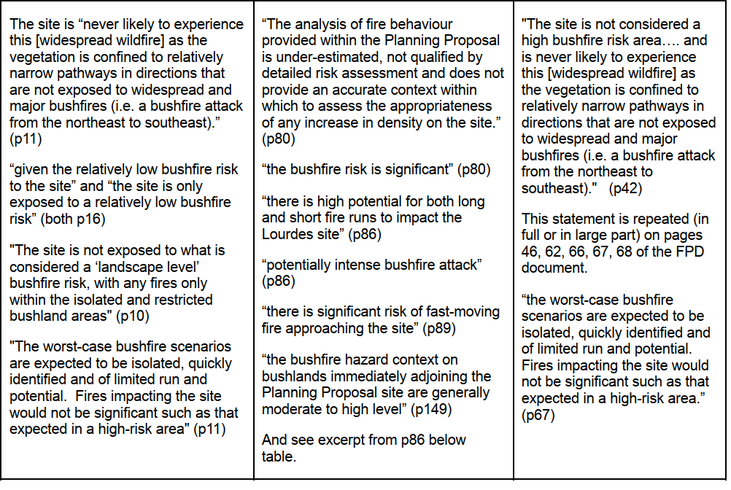
Expert modelling says Lourdes site is high risk
Notes:
Add statement from p149 re the high risk profile of the site

Slide 8
DPE report is not even handed
We are not surprised when a proponent’s consultant presents information in a way that favours the proponent, but it is alarming to see this bias in the DPE report. There is a notable lack of transparency and accuracy. For example, the report cites the 2018 SNPP decision that the proposal has strategic and site specific merit even though DPE knows that the proposal has changed significantly and the basis of those decisions no longer applies.
The FPD response to submissions and the DPE report fail to mention key Council conclusions and recommendations, e.g. that it would be negligent to approve the proposal, that there should be no development past First Ave, and that townhouses on the southern portion are not an appropriate building type. The DPE summary of the Council submission (p11) also fails to mention the lack of strategic merit which is detailed extensively in the Council submission.
The DPE report seeks to downplay Council concerns, copying text from its submission but changing key words: e.g. “serious failings” in Council sub (p31) becomes “inadequacies” in DPE report (p16)
We are shocked to read DPE’s conclusion that “No issues raised by Council prevent the progression of the planning proposal to finalisation. “ (p12)
The DPE report also seeks to lend RFS position credibility, e.g. it describes RFS as making “several submissions”. (p16) In fact, the RFS made 2 submissions and its advice in those submissions comprised just 6 dot points.

Slide 9
Gateway conditions are not met
The DPE report also glosses over issues, e.g.: it says that Gateway Condition 3 is met but this is not correct. The RFS was required to “specifically determine” whether townhouses were appropriate but it has not done so, saying it requires further information. Council submission deals with this and concludes townhouses are not appropriate.
DPE asserts that the RFS reply (re needing more information) meets the intent of the condition. Clearly, this is not the case.
DPE was alerted to the fact that TfNSW’s submission contained a manifest error because it referred only to traffic generated by the retirement village and did not acknowledge the 63 townhouses.
Despite knowing this, the DPE report accepts the TfNSW advice and even describes it as saying there are no evacuation issues. The Advice does not even mention evacuation.
This is very concerning.

Slide 10
Conclusion – keep R2, reduce HOB, FSR
Our concerns have not been addressed. Including areas zoned C2 and removing four townhouses does not go far enough.
The population on this site should not be allowed to double and townhouses should not be built in the flamezone.
Instead, defendable space must be provided to protect the lives of residents and firefighters, consistent with PBP 2019.
To achieve this, we ask that you
maintain R2 zoning across the site (in addition to proposed C2 zoning),
reduce degree of change to height and FSR controls, and
ensure no development occurs adjacent to bushland – consistent with the BlackAsh design strategy, PBP 2019 and the SNPP’s 2018 decision which contemplated the need to have no development adjacent to bushland to manage fire risks.
You have a duty of care to protect life. The risks posed by this proposal are clearly laid out in the Council submission.
As Council says, it would be negligent to approve this proposal.
Panel members will be held to account if lives are lost.

